Slide 1

AirBnB
Price Distribution

Slide 2
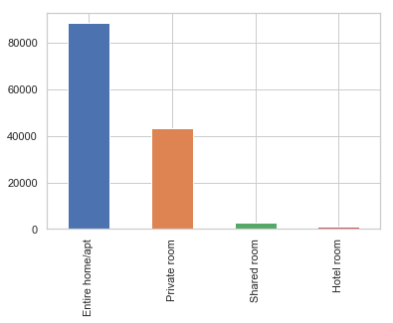
AirBnb Room Types
1
The vast majority of rooms are for entire apartments and private rooms.
2
Shared and hotel rooms make up a tiny amount of listings

Slide 3
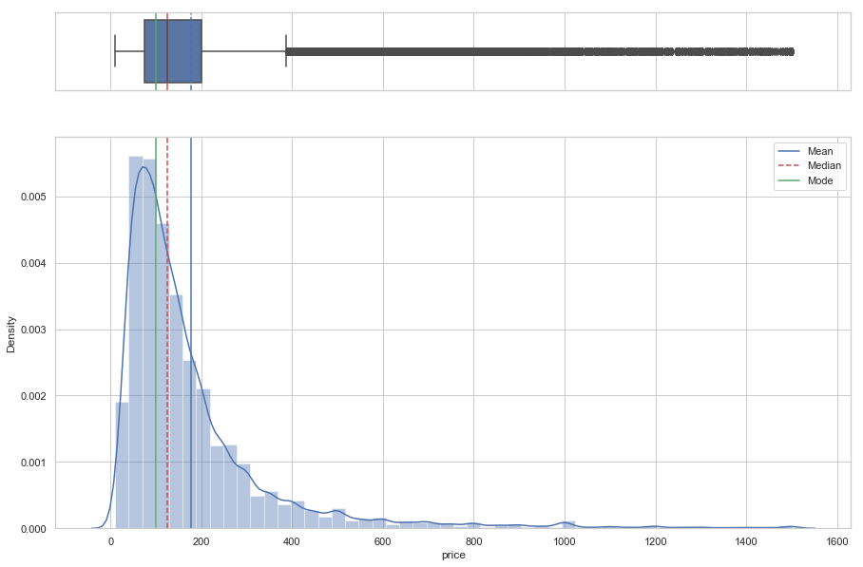
General Price Distribution
The overall price distribution is very positively skewed
This represents distribution when listing over $1500 are removed.

Slide 4
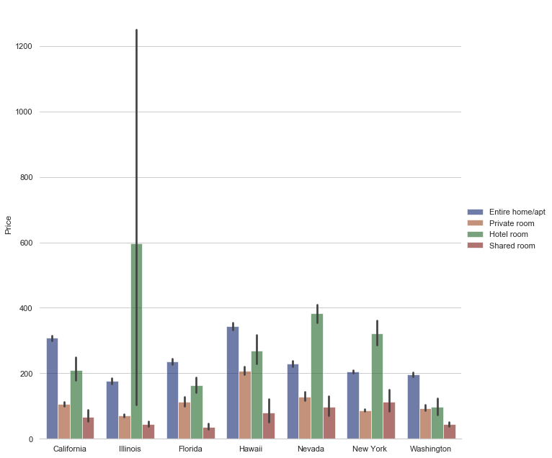
Mean price distribution by state & room type
Illinois, Nevada and New York contain larger proportion of hotel listings
Lots of outliers, high priced hotel rooms pushing the mean higher in Illinois.

Slide 5
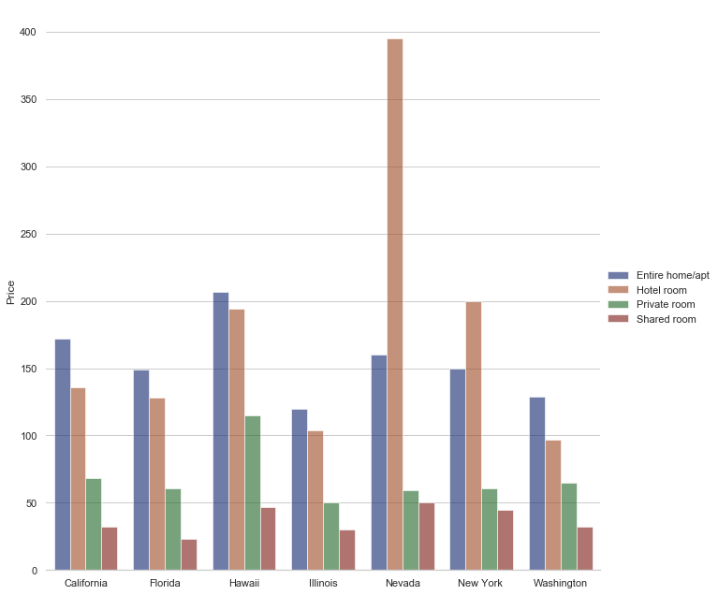
Median price distribution by state & room type
When the median is considered Illinois shows to have apartments with a higher price
New York and Nevada provides travellers with great value compared to hotel rooms.

Slide 6
Initial insight from price analysis
Median price is a better measure of price as there is a fat tail in the distribution leading to the mean being higher
Price for shared and private rooms are very similar across the country apart from Hawaii where private rooms are more expensive – supply being a lot less on an island?
Nevada contains a lot more high-priced hotel rooms – Las Vegas?
New York and Nevada provides travellers with great value compared to hotel rooms.

